Slide 1
JOC Cockpit Overview
JobScheduler Operations
Center: JOC Cockpit
Overview
Information for
Interested Parties

Slide 2
JOC Cockpit Motivation
Table of Contents
Motivation for the JOC Cockpit
  Pain Points with the classic JOC and JID
  Completely new User Experience
JOC Cockpit Architecture
JOC Cockpit Security Features
JOC Cockpit Visualization Features
JOC Cockpit Interaction Features

Slide 3
Motivation for the JOC Cockpit
Motivation: Pain Points with the classic JOC and JID
Architecture
  JOC ships on top of a Master and is restricted to control that Master
  Separate components JOC and JID have to be used
  Information is scattered across different components without interaction
Security
  Limited capabilities for authentication
  Missing authorization, missing roles
Navigation
  Navigation issue: users are forced to switch tabs
  Usability issue: no consistent information available
Visualization
  Presentation issue: textual representation, no graphical representation
  Consistency issue: no system status overview available
  Design issue: no modern design of graphical controls and use of color
Interaction
  Missing responsiveness, no mobile devices, page refresh required
  Options deeply buried in context menus

Slide 4
Motivation for the JOC Cockpit
Motivation: Competely new User Experience
Architecture
  Platform agnostic component to control a number of Master instances
  Introduction of a RESTful Web Service for access to JobScheduler
Security
  Role based authentication and authorization including LDAP support
Navigation
  Modern design for better user interaction
  Clear context menus when performing actions
Visualization
  Textual and graphical representation (Flow Charts, Gantt Charts)
  Dashboard available for system status overview
Interaction
  Near real-time information about jobs, job chains and orders is automatically displayed and refreshed
  Support for desktops, notebooks and mobile devices
  Bulk operations such as stopping all job chains, skipping all nodes or removing all orders associated to a job chain

Slide 5
JOC Cockpit Architecture
Table of Contents
Motivation for the JOC Cockpit
JOC Cockpit Architecture
  Component Architecture
  Technical Architecture
JOC Cockpit Security Features
JOC Cockpit Visualization Features
JOC Cockpit Interaction Features

Slide 6

JOC Cockpit Architecture
Component Architecture
Component Architecture
The JOC Cockpit is a user interface for job control with browsers
JobScheduler Web Service implements a RESTful interface for use by the JOC Cockpit, PowerShell CLI and by external applications
Users access the Master using the Web Service that performs authentication and authorization – optionally against an LDAP directory
Users call up information and manage JobScheduler activities, e.g. current executions, planned executions, history etc.
With the JOC Cockpit it is possible to operate several Master Instances and any number of JobScheduler Agents that execute jobs and tasks for the Masters
JOC Cockpit
User Interface
User Interface for job control
PowerShell
CLI
Scripting Interface
Programming Interface
External
Applications
LDAP
Directory
JobScheduler Web Service
Authentication and Authorization
JobScheduler
Master
JobScheduler
Master
JobScheduler
Master
Agents
Agents
Agents
Database
Database Access
Database Access
Database Access

Slide 7
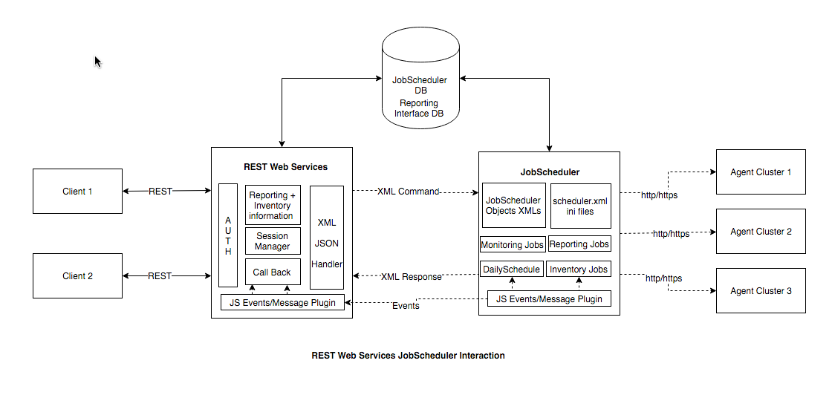
JOC Cockpit Architecture
Technical Architecture
Technical Architecture
HTTP/HTTPS is used for communication between the RESTful Web Services and the JOC Cockpit - or other applications
The Web Service uses JSON and XML based commands to communi-cate with the Masters
Events about object status changes are communicated between the Masters and the Web Service
Authentication and authorization is carried out by an Apache Shiro framework integrated into the Web Service

Slide 8
JOC Cockpit Security Features
Table of Contents
Motivation for the JOC Cockpit
JOC Cockpit Architecture
JOC Cockpit Security Features
  Role based Authentication and Authorization
  Default Roles
  Matrix of Default Roles and Permissions
  Single Sign-On
JOC Cockpit Visualization Features
JOC Cockpit Interaction Features

Slide 9
JOC Cockpit Security Features
Role based Authentication and Authorization
What is predefined:
  Number and type of JobScheduler operations and object permissions
  Operations include to view jobs, start and stop jobs etc.
What is configurable:
  Number and type of roles
  Permission values (yes/no) are configured for each operation and role
  Users can be assigned to any of the roles offered
Identity Provider
  LDAP for e.g. Microsoft Active Directory, Open LDAP etc.
  Local shiro.ini file containing user name and passwords
Mapping of Permissions to Roles
  The mapping can be configured with a local shiro.ini file
  The mapping can be configured with an LDAP directory service that identifies group membership of users with specific user groups that are mapped to JOC Cockpit roles

Slide 10
JOC Cockpit Security Features
Default Roles
Administrator
  Technical role without any responsibilities in the IT process
Application Manager
  Engineering role with in-depth knowledge of jobs and job chains, however, not necessarily involved in daily operations
IT Operator
  Role for daily operations of jobs and job chains
Incident Manager
  Role for the IT Service Desk, e.g. 1st and/or 2nd level support, for interventions and Incident Management
Business User
  Role for backoffice users not responsible for IT (probably for Business Processes)
API User
  Role is intended for applications that access JobScheduler via its API

Slide 11
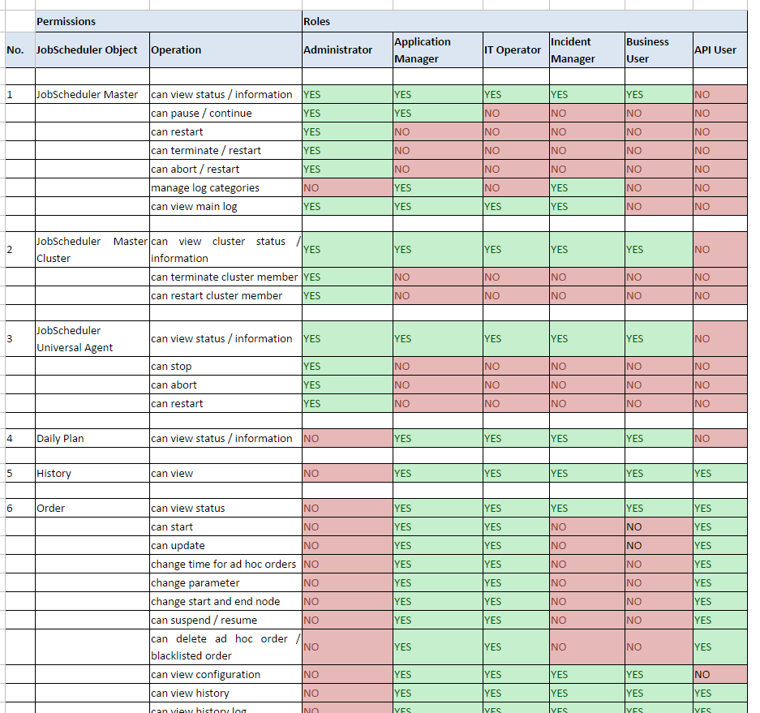
JOC Cockpit Security Features
Matrix of Default Roles and Permissions

Slide 12
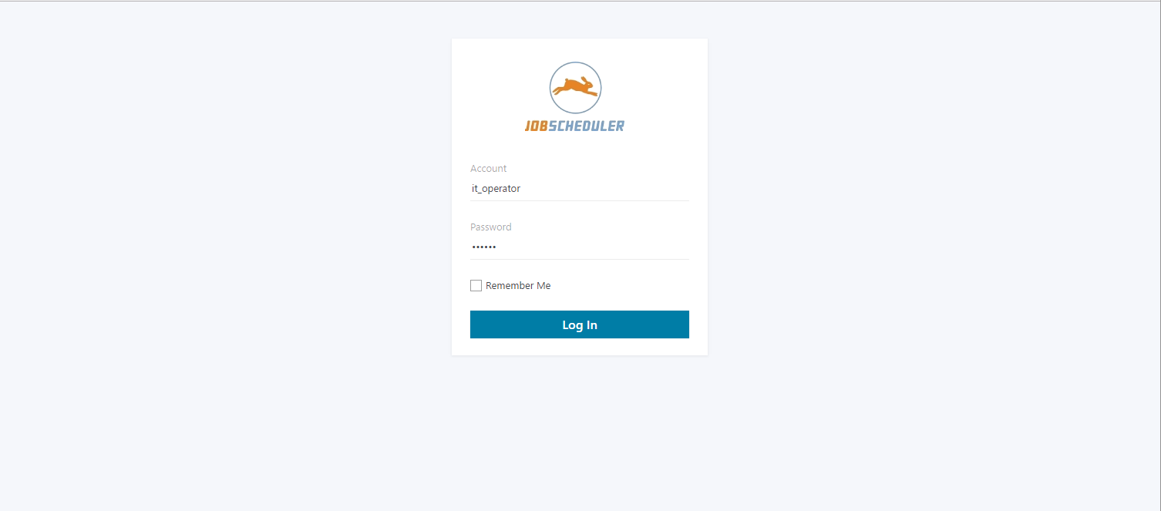
JOC Security Features
Single Sign-On
Authentication
Direct authentication via LDAP is provided
Alternatively use of a local shiro.ini file for authentication
Authorization
Roles and Operations are predefined
Permissions are configu-red for the roles in the local shiro.ini file
Roles can be managed with the LDAP directory service by group membership of users
Alternatively roles can be managed in the local shiro.ini file

Slide 13
JOC Cockpit Visualization Features
Table of Contents
Motivation for the JOC Cockpit
JOC Cockpit Architecture
JOC Cockpit Security Features
JOC Cockpit Visualization Features
  Dashboard
  Daily Plan
  Card View
  Table View
  Graphical View
  Resources View
JOC Cockpit Interaction Features

Slide 14
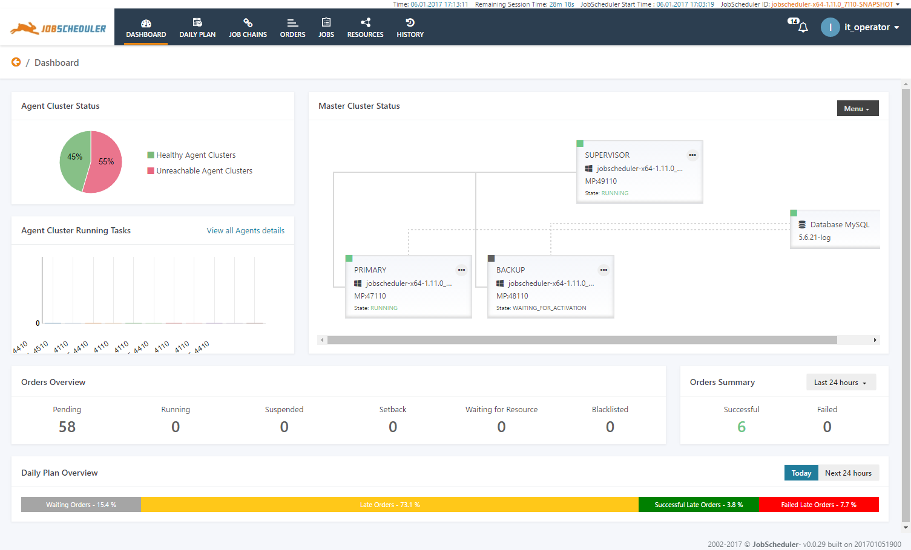
JOC Cockpit Visualization Features
Dashboard
Dashboard
The Dashboard offers a comprehensive overview of most relevent informa-tion in the form of widgets
Information in the Dash-board is updated automa-tically in near real-time
The Dashboard shows the JobScheduler Master status including cluster information
The Agent overview shows healthy and unhealthy Agent Clusters
The Dashboard is a starting point to navigate to objects of interest, e.g. failed orders, suspended orders, late orders etc.

Slide 15
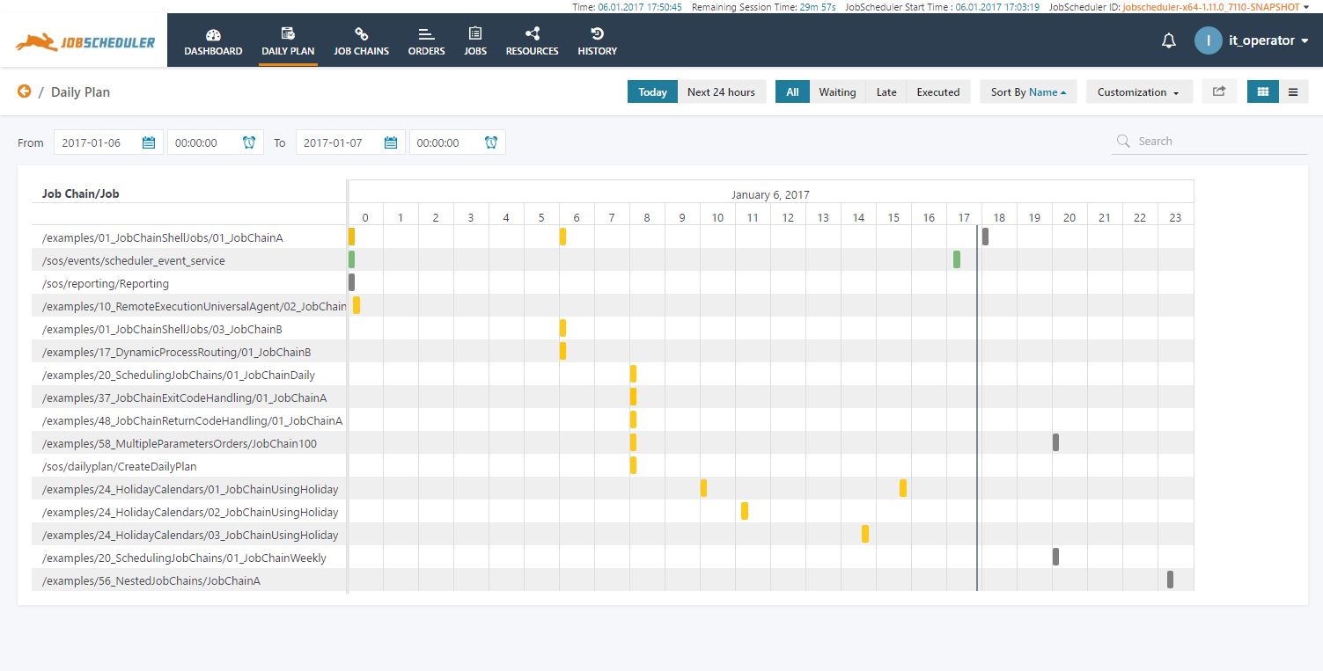
JOC Cockpit Visualization Features
Daily Plan: Graphical Overview (Gantt Chart)
Graphical Daily Plan
The Daily Plan graphical overview is represented in a Gantt diagram
See at a glance what is running, what is queued, what was suspended
Color coded information for recognition rather than recall

Slide 16
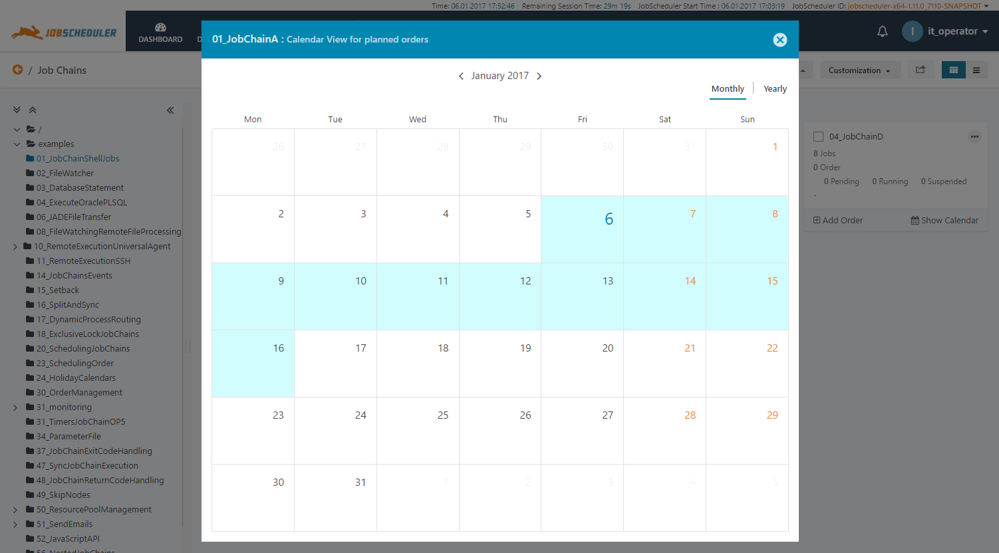
JOC Cockpit Visualization Features
Daily Plan: Calendar View
Graphical Calendar View
The calendar view allows to check future start dates of job chains
The daily plan is updated automatically to reflect changes in order start times
The calendar view allows a preview for the forth-coming days and months

Slide 17
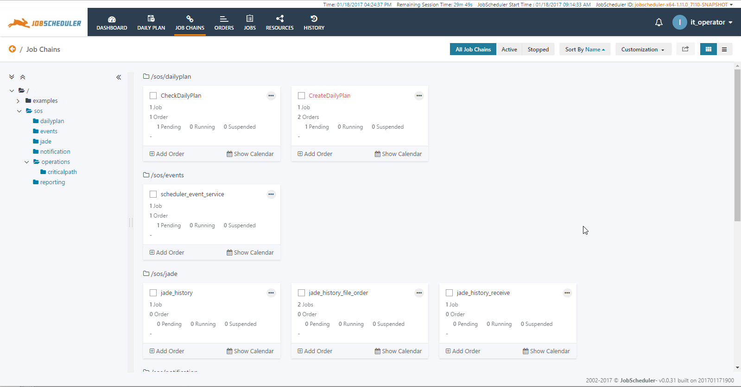
JOC Cockpit Visualization Features
Card View: Quick Overview of Objects
Card View
The graphical card view shows a comprehensive list of objects and the most frequently used information
Cards include the most frequently offered operations on objects for a single click
Additional operations are available from context menues

Slide 18
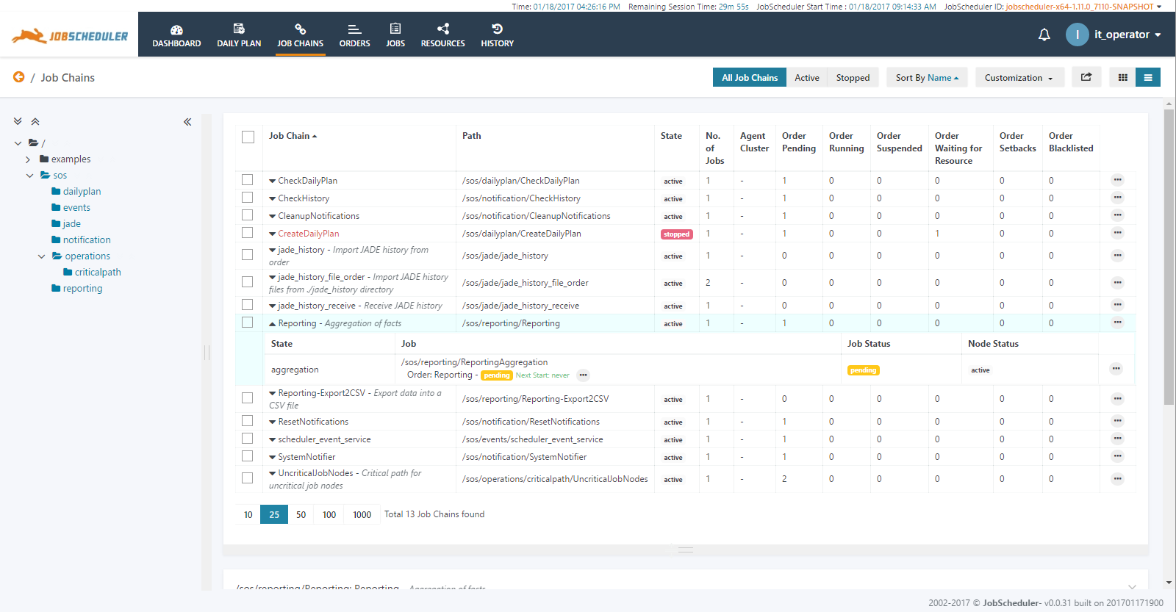
JOC Cockpit Visualization Features
Table View (1/3): Job Chains
Table View: Job Chains
The table view shows a concise list of objects and important information
The status of each object is visible including job chains, jobs, orders, tasks
Operations are available by context menues for all visible objects
The table view can be used for monitoring purposes as the view is updated automatically for tasks started and completed

Slide 19
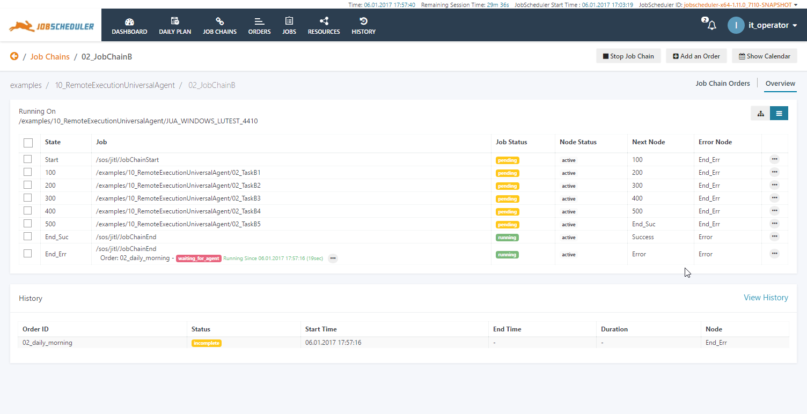
JOC Cockpit Visualization Features
Table View (2/3): Job Chain Details
Table View for Details
The table view shows the detailed list of objects that are available for a single job chain
This view can be used for monitoring purposes as the view is updated automatically for tasks started and completed

Slide 20
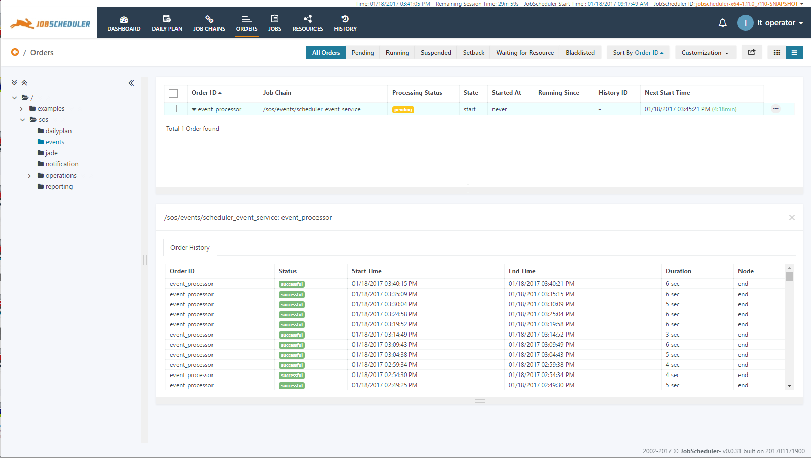
JOC Cockpit Visualization Features
Table View (3/3): Orders
Table View: Orders
The table view shows a concise list of orders and important information
The status of each order is visible together with next start time
Operations such as Start Order At and Set Run-time are available by context menues for all visible objects
The table view can be used for monitoring purposes as the view is updated automatically for orders started and completed
This view also shows information about the last 30 executions of the selected order

Slide 21
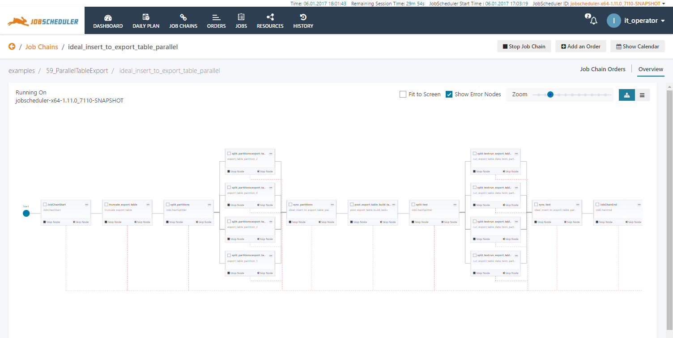
JOC Cockpit Visualization Features
Graphical View: Flow Charts
Graphical Flow Chart
The flow chart view shows a graphical representation of objects in a job chain
Typical dependency patterns such as split & sync are considered
The flow chart allows to zoom-in and zoom-out to make details visible
All applicable operations on objects are available from the flow chart view, e.g. starting orders
This view can be used for monitoring purposes as the view is updated automatically for tasks started and completed

Slide 22
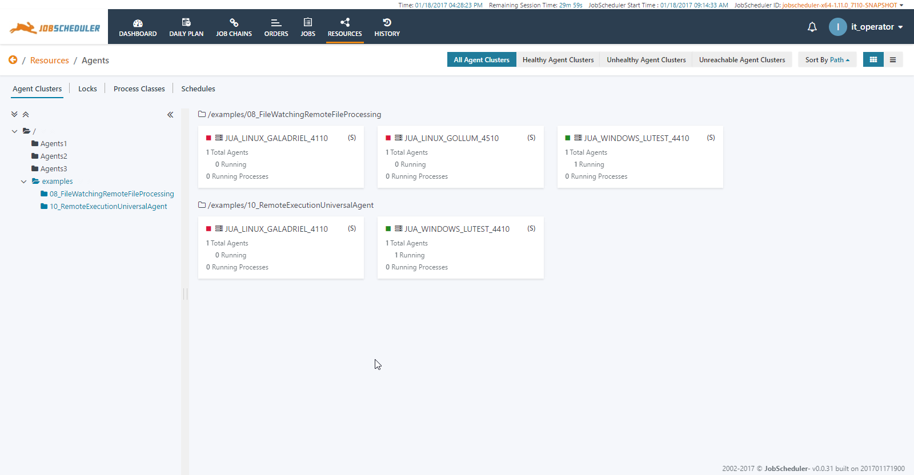
JOC Cockpit Visualization Features
Resources View: Agents, Locks, Schedules
Resources View
The resources view shows the status and availability of resources that are required to execute jobs
Resources include Agents that operate on remote hosts, locks that apply mutual exclusion on jobs and schedules that specify common run-times
The example shows a number of Agent Clusters that are partly available and partly unavailable

Slide 23
JOC Cockpit Interaction Features
Table of Contents
Motivation for the JOC Cockpit
JOC Cockpit Architecture
JOC Cockpit Security Features
JOC Cockpit Visualization Features
JOC Cockpit Interaction Features
  Manage related Objects
  Query the Order History
  Perform Bulk Operations
  Adding Orders on-the-fly
  Advanced Filtering and Customizations

Slide 24
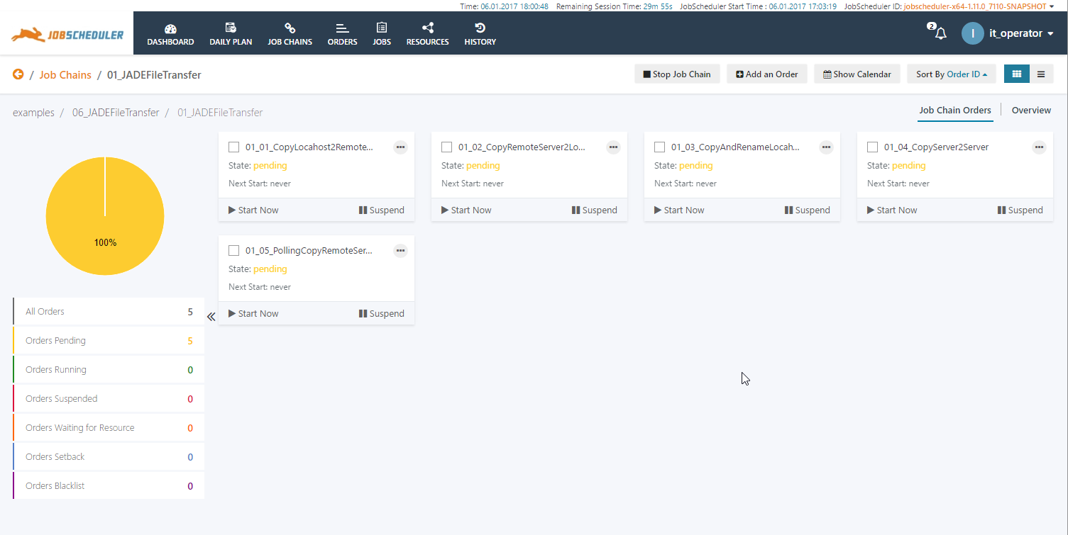
JOC Cockpit Interaction Features
Manage related Objects
Interaction Features
Users can navigate between related JobScheduler objects
Example 1: From a job chain the user wants to see a specific order which triggers this job chain
Example 2: A user sees that a job chain has not run successfully and wants to check out whether the specific JobScheduler Agent is available for which the job chain is scheduled

Slide 25
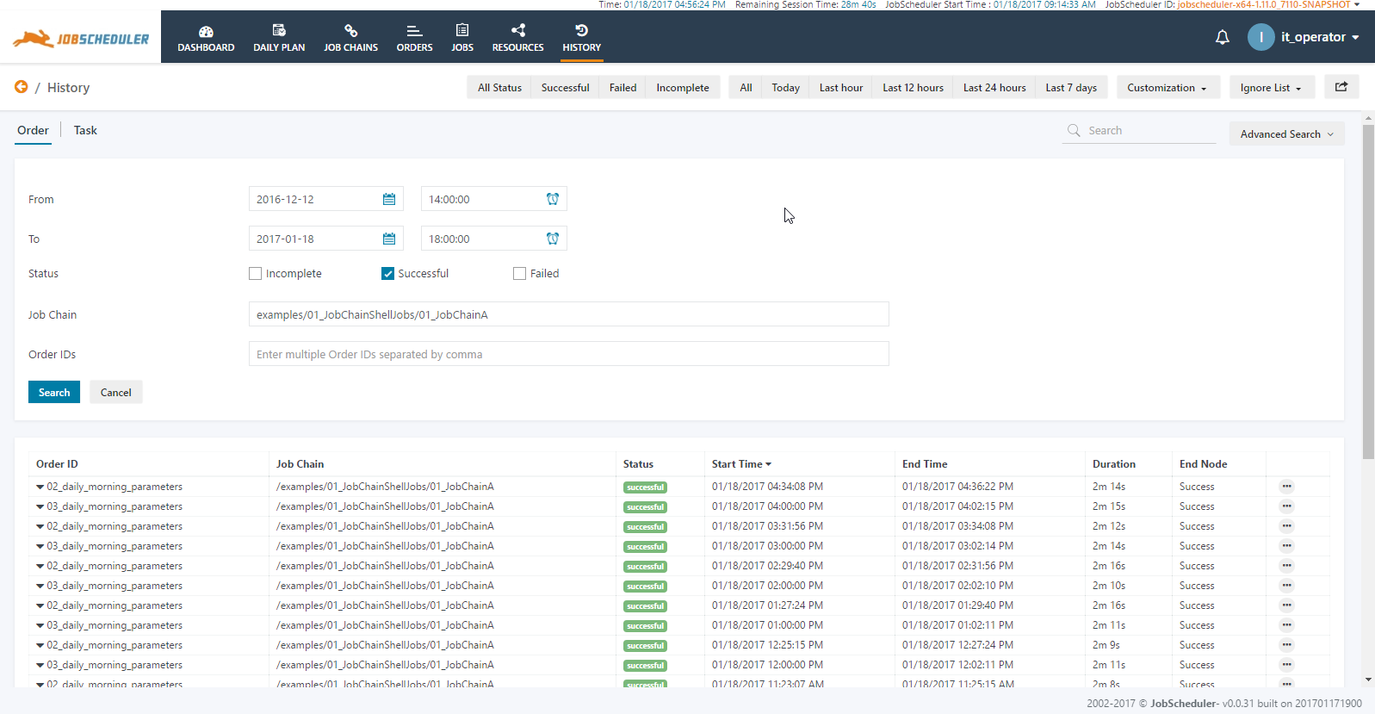
JOC Cockpit Interaction Features
Query the Order History
Order History
This example shows the filtering for the History
An Advanced Search is available for more granular search criteria
Time ranges can be specified as well as job chains and orders being selected for granular filtering
Advanced Search helps to quickly find history information of job chains and orders over a time range and to search by status, e.g. to show all successful executions of a specific job chain, e.g. examples/01_JobChainShellJobs/01_JobChainA , between a time range

Slide 26
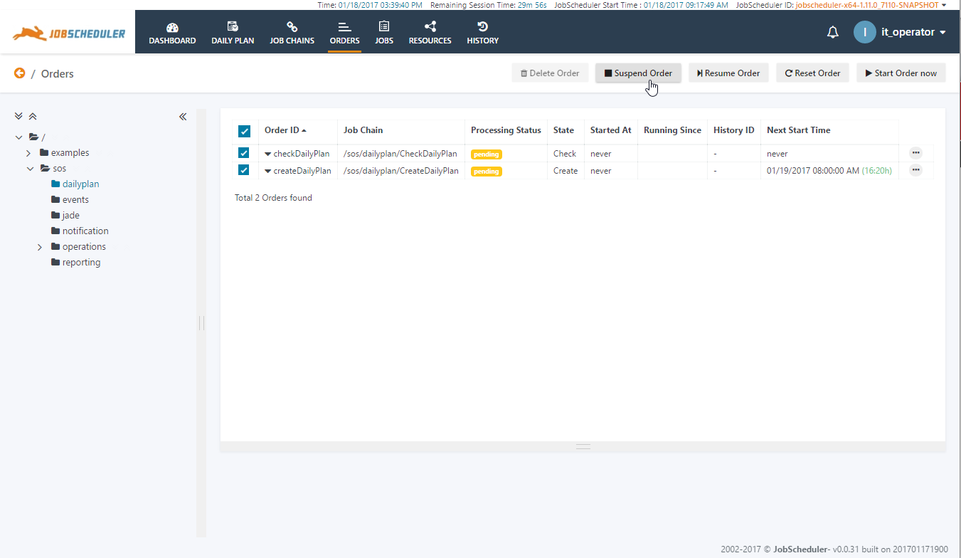
JOC Cockpit Interaction Features
Perform Bulk Operations
Bulk Operations
The JOC Cockpit offers the capability of perfor-ming bulk operations on two or more orders, job chains or jobs
The Bulk Operations can be performed on a group of objects of the same status, e.g. group of orders in processing status, pending and suspended orders can be selected

Slide 27
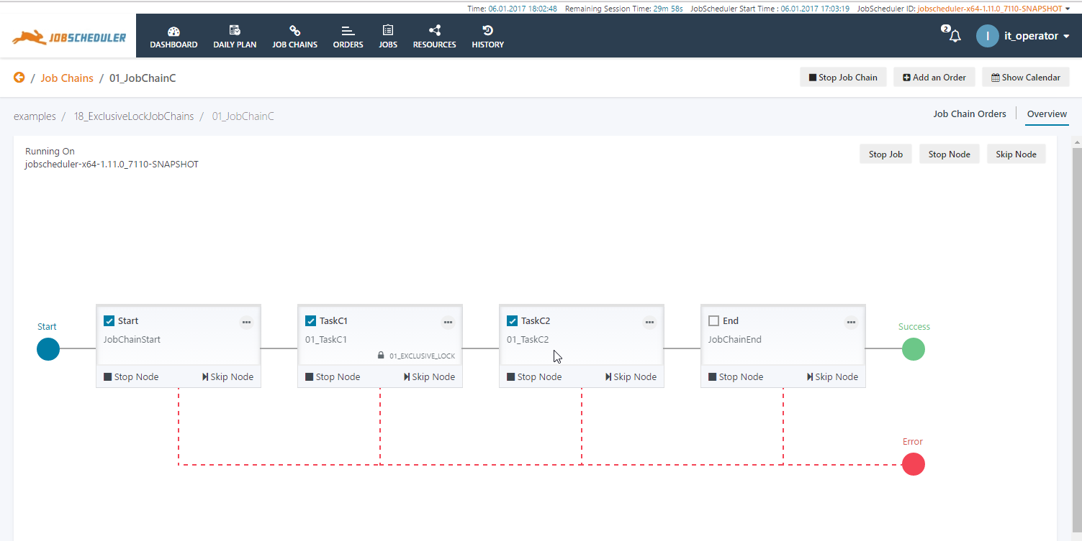
JOC Cockpit Interaction Features
Adding Orders on-the-fly (1/2)
Adding Orders
This example shows the the graphical flow chart view of a job chain
This view can be used as a starting point to add orders on-the-fly

Slide 28
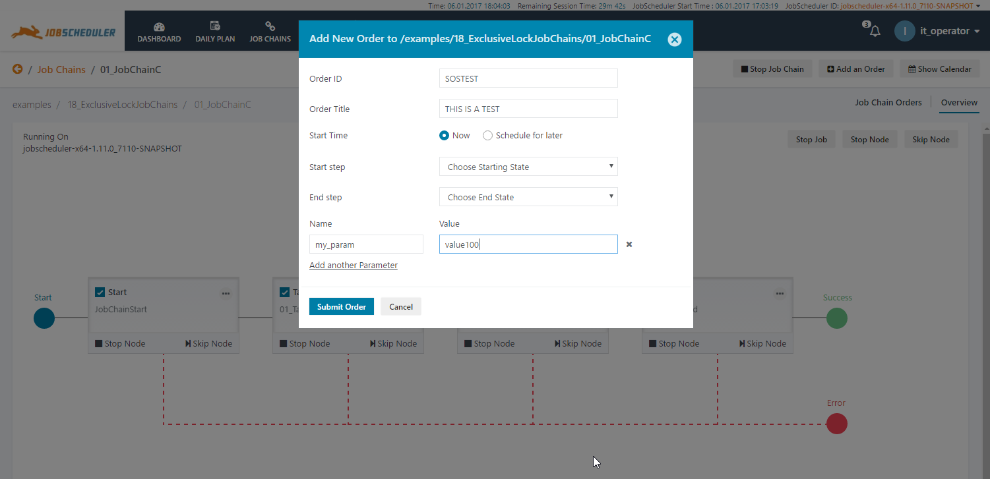
JOC Cockpit Interaction Features
Adding Orders on-the-fly (2/2)
Adding Orders
When adding an order then a pop-up window appears that allows to enter detailed information
The order entry window is used by all views that allow to add orders
on-the-fly

Slide 29
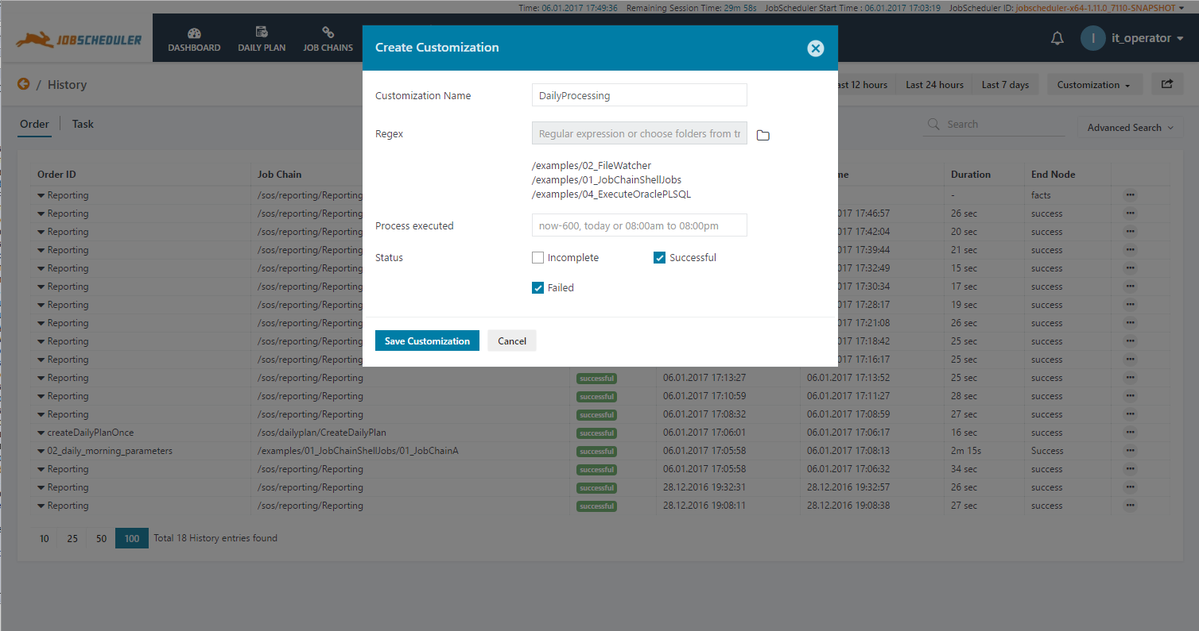
JOC Cockpit Interaction Features
Advanced Filtering and Customizations
Advanced Filtering and Customizations
This example shows the Customization for the Order History
The folders are being selected for granular filtering
Customizations help to create customized work views for individuals or a team
Customizations can be shared across teams

Slide 30
JOC Cockpit Overview
Software- und
Organisations-
Service GmbH
Giesebrechtstr. 15
D-10629 Berlin
info@sos-berlin.com
http://www.sos-berlin.com
Questions?
Comments?
Feedback?

